Slide 1

光纤显微图像重建的 机器学习方法
陈照青
2020040904012

Slide 2
目录
研究背景
研究现状
研究内容
研究方法及关键技术
课题进度安排

Slide 3
研究背景
PART
01
02
03
04

Slide 4
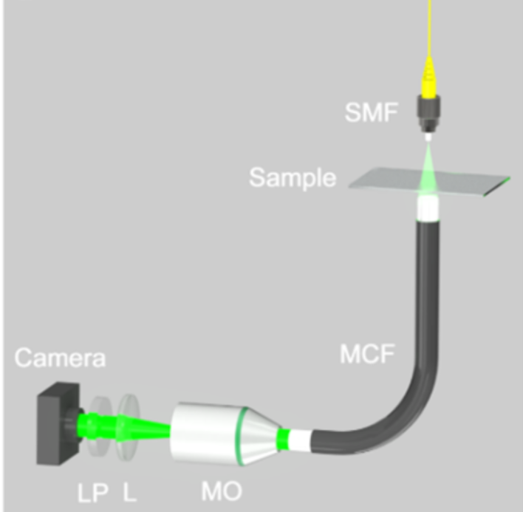
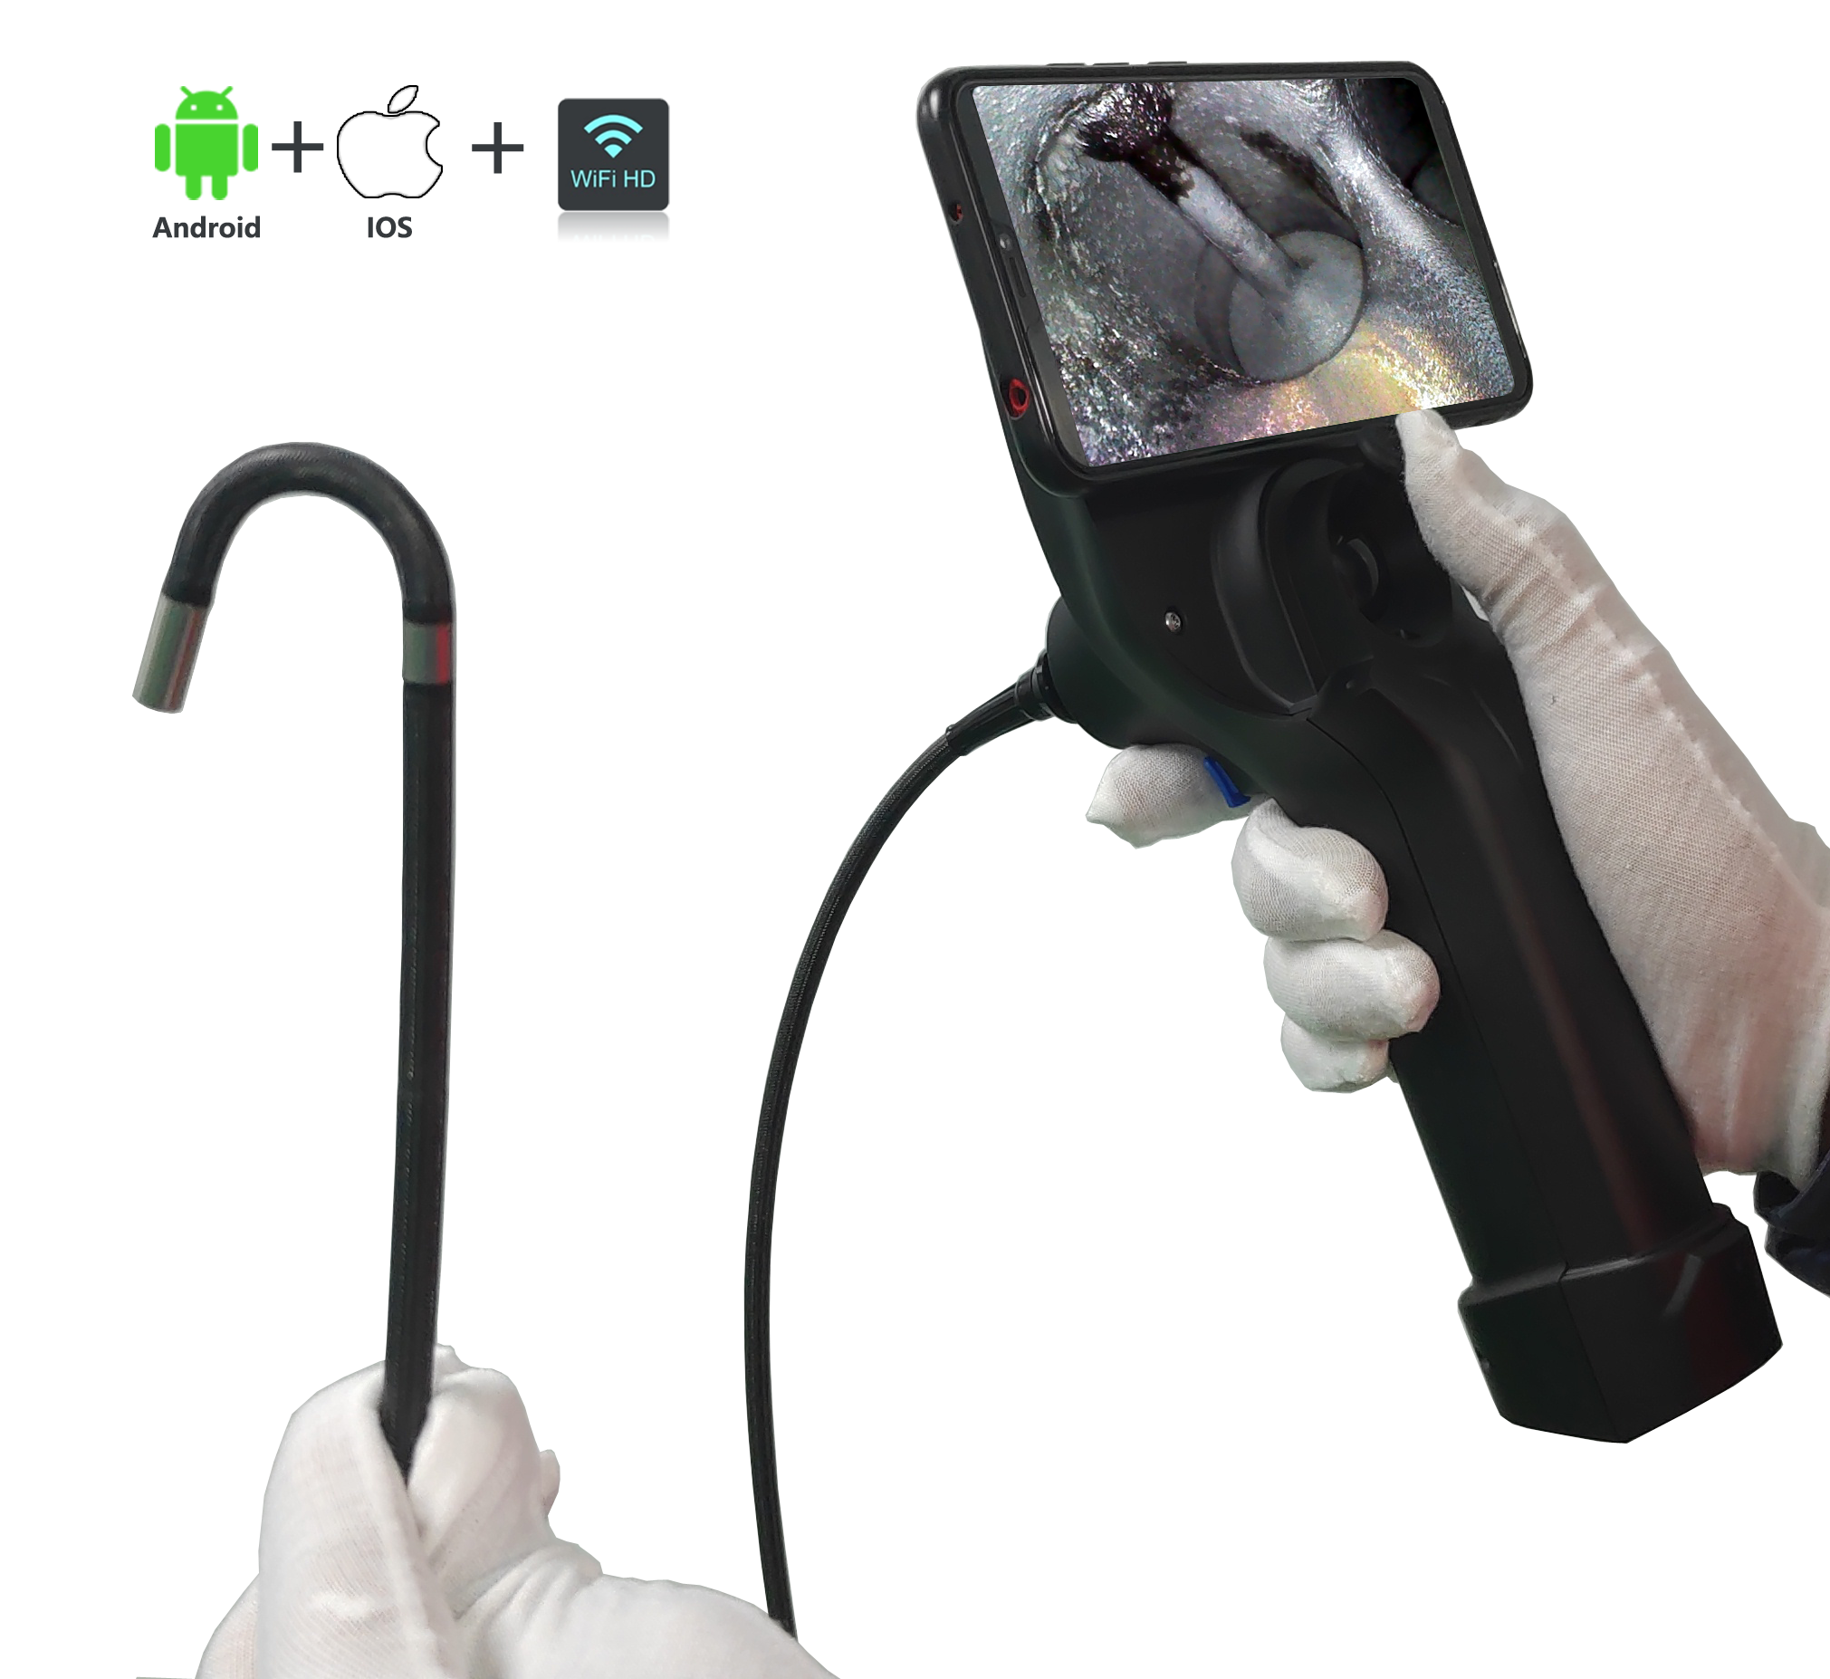
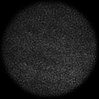
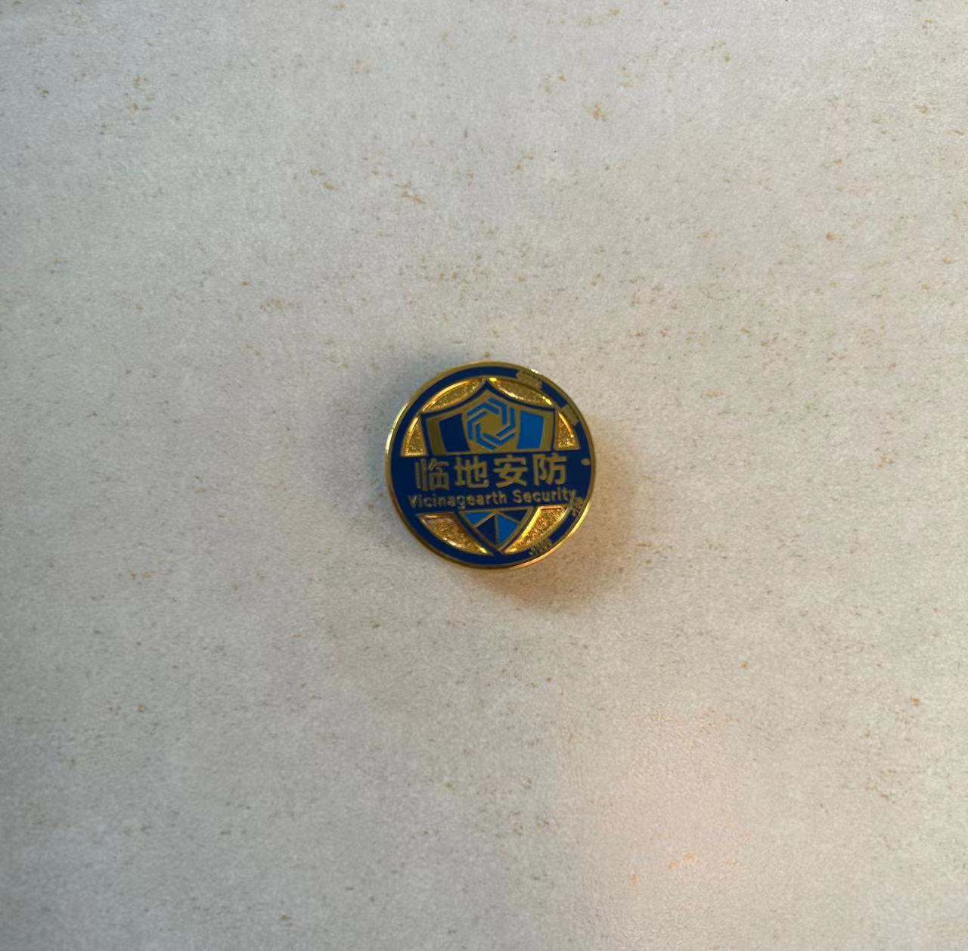
无透镜光纤内窥镜
传统内窥镜：基于透镜组的光纤内窥镜
新型内窥镜：无透镜光纤内窥镜镜
优势：尺寸小，柔韧性好 → 可对狭窄区域进行高分辨率成像
重要应用：医学体内成像、芯片制造、航空发动机检修等
~350um
传统内窥镜
超细柔性光纤束（MCF）
无透镜光纤内窥镜

Slide 5
研究现状
01
PART
02
03
04
05

Slide 6
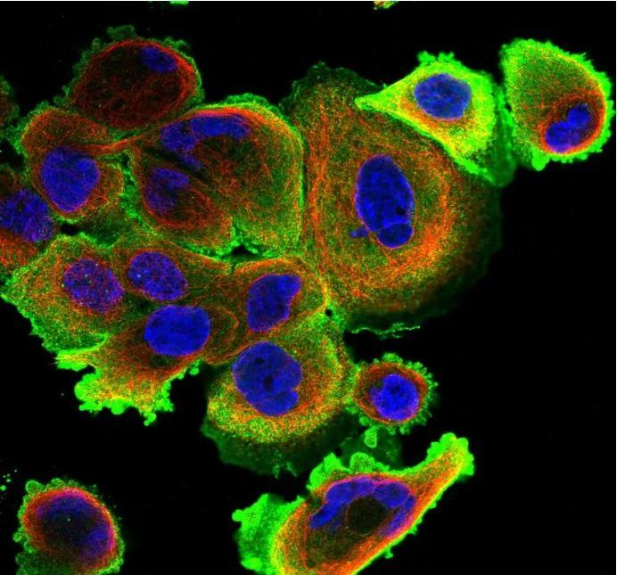
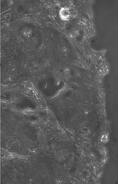
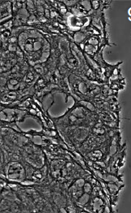
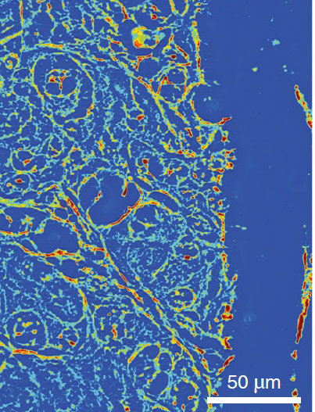
成像技术
荧光成像技术
定量相位成像
方法：利用染剂增强图像对比度
缺点：可能将有害化学试剂引入体内
方法：利用相位信息，提高图像对比度
优点：无需染色即可提升图像质量，可提供样本的折射率和干质量等重要信息
荧光成像技术
定量相位成像

Slide 7
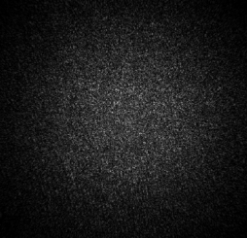
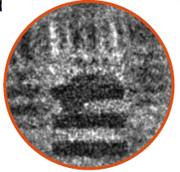
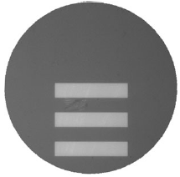
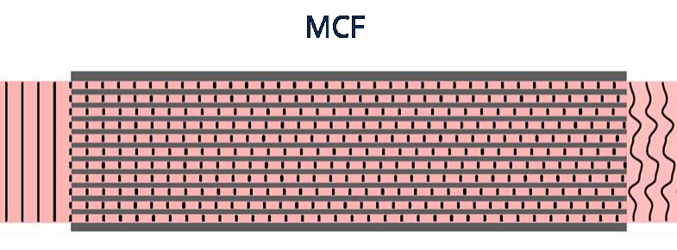
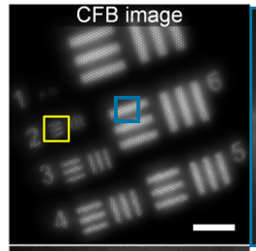
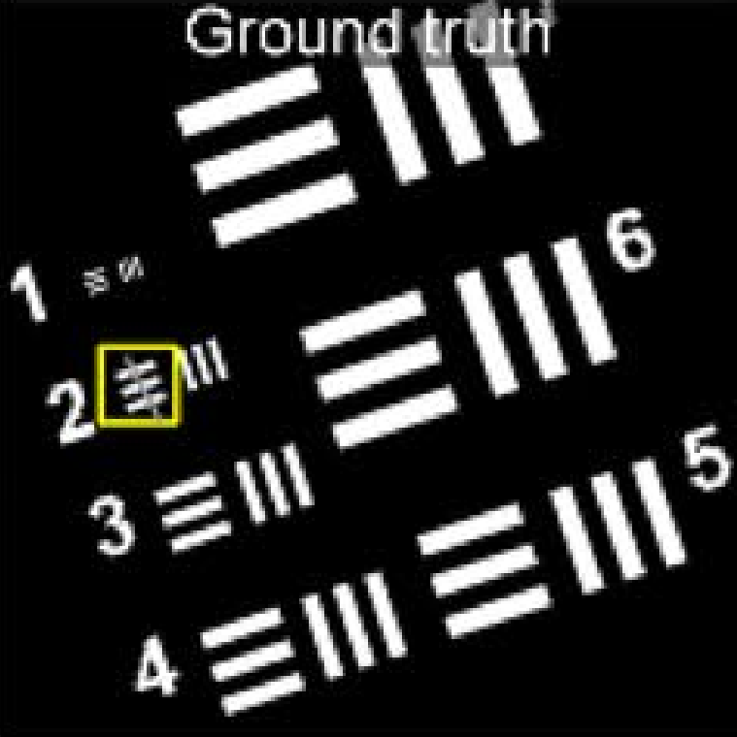
定量相位成像
定量相位成像缺点
定量相位成像质量差
问题原因
上万独立光纤芯中的光程差导致的光场相位失真
离散的纤芯分布导致纤芯间图像信息缺失
多芯光纤中的定量相位成像
纤芯间图像信息缺失
相位失真

Slide 8
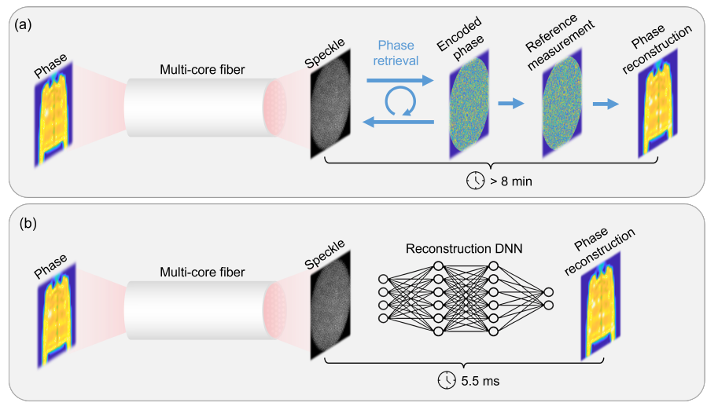
相位图像恢复算法
传统相位图像恢复算法
Gerchberg-Saxton算法和FAST算法
内容：通过迭代计算入射和出射光场以恢复图像相位
优点：在相位失真较大时，仍能有效恢复相位图
缺点：成像质量差，处理速度慢
深度学习算法
Unet模型
内容：通过Unet模型实现端到端的相位图像恢复
优点：成像质量高，处理速度快
缺点：在重建高分辨率图像时，成像质量较差
传统相位恢复算法与深度学习算法

Slide 9
研究内容
01
02
PART
03
04
05
06

Slide 10
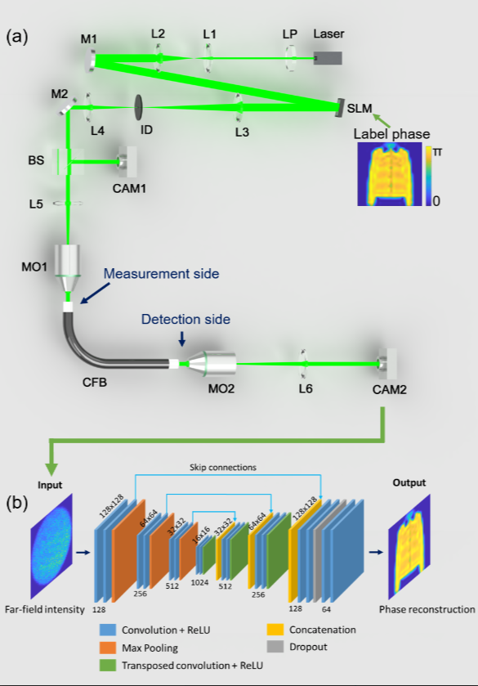
研究内容
数据集获取
搭建多芯光纤无透镜成像的光学系统
利用该光学系统，生成远场散斑图像数据集
模型开发
开发深度学习模型，实现由远场散斑图像重建真实图像
结合具体场景，优化图像重建模型
性能测试
测试图像重建模型的重建效果、光学性能和泛化性
多芯光纤无透镜成像系统

Slide 11
研究方法及关键技术
02
03
PART
04
05
06
07

Slide 12
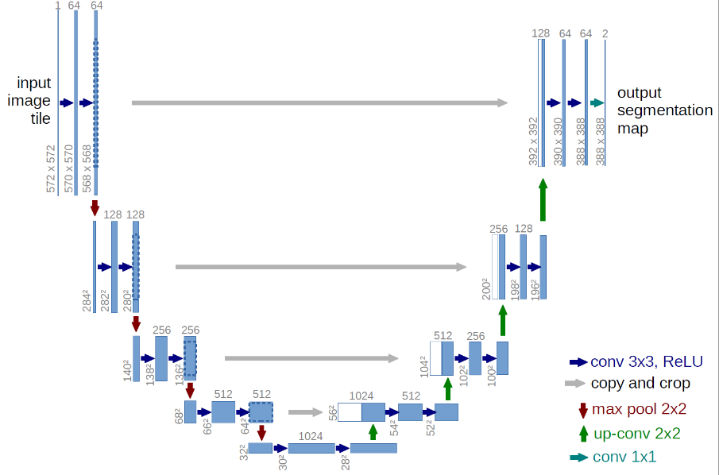
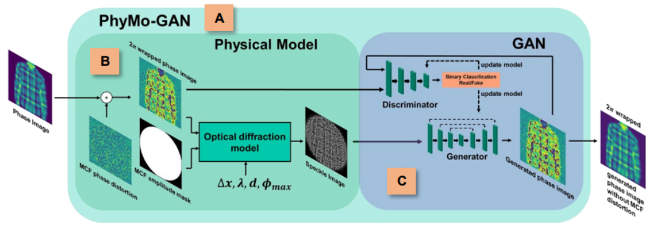
模型开发
Unet复现
GAN模型搭建
方法：采用了编码器-解码器结构，前半部
分为特征提取， 后半部分为上采样
优点：最简单、最常用的图像重建模型
方法：通过生成器和判别器的对抗，生成与原始数据相似的实例
优点：生成图像质量高
缺点：训练不稳定，生成高分辨率图像时效果较差
Unet模型
GAN模型

Slide 13
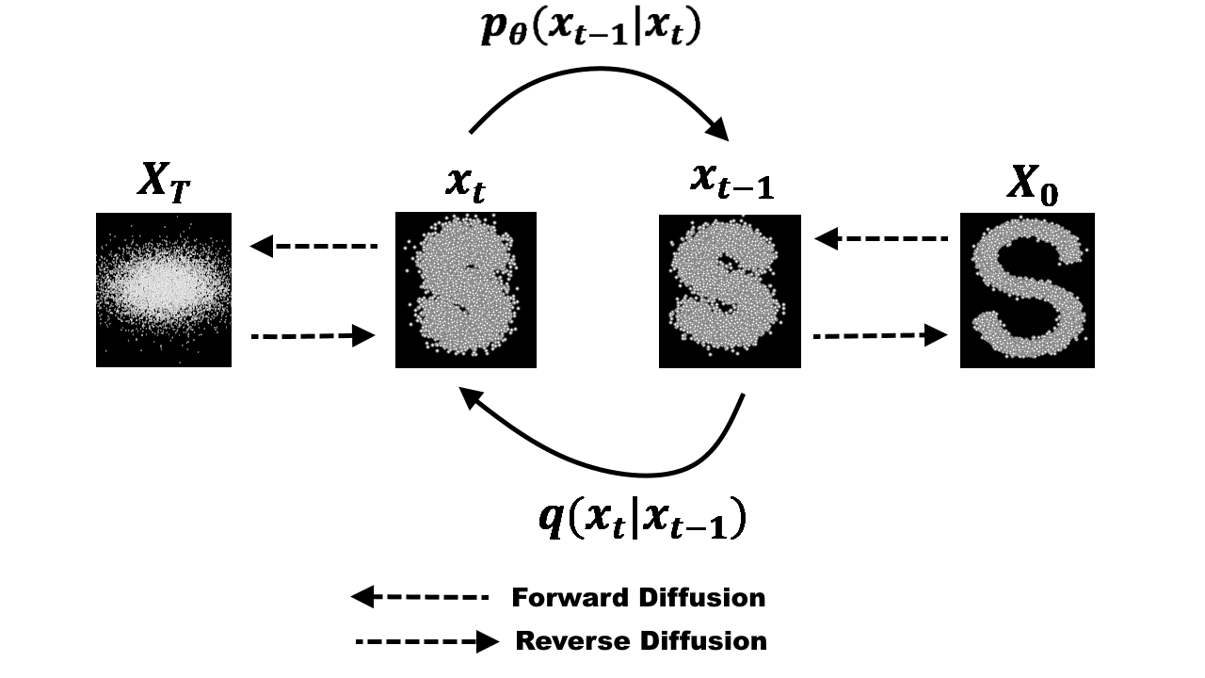
模型开发
Diffusion模型搭建
方法：通过一系列高斯噪声，将输入图片逐渐转变为纯高斯噪声，随后模型将高斯噪声逐渐恢复为原图像
优点：生成高分辨率图像时，图像质量高，纹理与细节丰富
缺点：图像生成时间较长
Diffusion模型

Slide 14
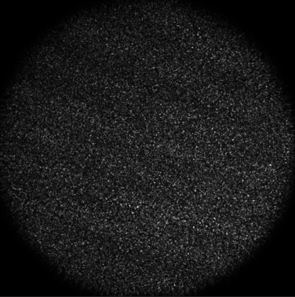
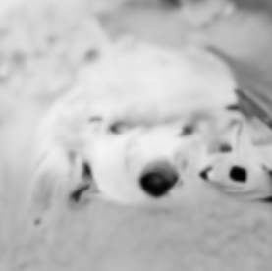
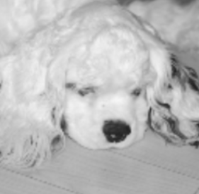
性能测试
图像重建效果
测试模型在Imagenet数据集上的重建效果
光学表征
使用1951 USAF分辨率测试板，基于Abbe Limit准则，确定图像重建后能达到的最小分辨率
泛化性
a.远场散斑图
b.生成图
c.真实图
通过迁移学习，将模型应用于细胞图像数据集，测量重建细胞图像的精度
利用大模型SAM对比真实细胞图片和生成细胞图片的细胞分割图，计算两者的交并比
Imagenet图像重建初步效果

Slide 15
课题进度安排
03
04
PART
05
06
07
08

Slide 16
课题进度安排
课 题 进 度 安 排 | 起止时间 | 完成内容
 | 七学期10-12周 | 背景调研
 | 七学期13-14周 | 复现光纤显微图像重建的sota模型
 | 七学期15-16周 | 复现光纤显微图像重建的sota模型
 | 七学期17-18周 | 将GAN模型应用到光纤显微图像重建
 | 七学期19-20周 | 将Diffusion模型应用到光纤显微图像重建

Slide 17
课题进度安排
课 题 进 度 安 排 | 起止时间 | 完成内容
 | 八学期1-2周 | 计算光纤显微图像重建的测试指标
 | 八学期3-4周 | 测试图像重建模型的泛化能力
 | 八学期5-6周 | 毕业论文撰写
 | 八学期7-8周 | 毕业论文撰写
 | 八学期9-10周 | 论文终稿修改
 | 八学期11-12周 | 准备毕业设计答辩

Slide 18
参考文献
[1]J. Sun, J. Wu, S. Wu, R. Goswami, S. Girardo, L. Cao, J. Guck, N. Koukourakis, and J. Czarske, "Quantitative Phase Imaging Through an Ultra-Thin Lensless Fiber Endoscope," Light: Science & Applications, vol. 11, no. 1, pp. 204, 2022.
[2]R. Kuschmierz, E. Scharf, D. Ortegón-González, T. Glosemeyer, and J. Czarske, "Ultra-Thin 3D Lensless Fiber Endoscopy Using Diffractive Optical Elements and Deep Neural Networks," Light: Advanced Manufacturing, vol. 2, no. 4, pp. 415-424, 2021.
[3]W. Göbel, J. Kerr, A. Nimmerjahn, and F. Helmchen, "Miniaturized Two-Photon Microscope Based on a Flexible Coherent Fiber Bundle and a Gradient-Index Lens Objective," Optics Letters, vol. 29, no. 21, pp. 2521-2523, 2004.
[4]N. Badt and O. Katz, "Real-Time Holographic Lensless Micro-Endoscopy Through Flexible Fibers via Fiber Bundle Distal Holography," Nature Communications, vol. 13, no. 1, pp. 6055, 2022.
[5]J. Wu, T. Wang, O. Uckermann, R. Galli, G. Schackert, L. Cao, J. Czarske, and R. Kuschmierz, "Learned End-to-End High-Resolution Lensless Fiber Imaging Towards Real-Time Cancer Diagnosis," Scientific Reports, vol. 12, no. 1, pp. 18846, 2022.
[6]Y. Park, C. Depeursinge, and G. Popescu, "Quantitative Phase Imaging in Biomedicine," Nature Photonics, vol. 12, no. 10, pp. 578-589, 2018.
[7]J. Sun and J. Czarske, "Compressive Holographic Sensing Simplifies Quantitative Phase Imaging," Light: Science & Applications, vol. 12, no. 1, pp. 121, 2023.
[8]R. Kuschmierz, E. Scharf, N. Koukourakis, and J. Czarske, "Self-Calibration of Lensless Holographic Endoscope Using Programmable Guide Stars," Optics Letters, vol. 43, no. 12, pp. 2997-3000, 2018.
[9]J. Lee, H. Kim, H. Cho, Y. Jo, Y. Song, D. Ahn, K. Lee, Y. Park, and S. Ye, "Deep-Learning-Based Label-Free Segmentation of Cell Nuclei in Time-Lapse Refractive Index Tomograms," IEEE Access, vol. 7, pp. 83449-83460, 2019.
[10]H. Hai, S. Pan, M. Liao, D. Lu, W. He, and X. Peng, "Cryptanalysis of Random-Phase-Encoding-Based Optical Cryptosystem via Deep Learning," Optics Express, vol. 27, no. 15, pp. 21204-21213, 2019.
[11]F. Helmchen, M. Fee, D. Tank, and W. Denk, "A Miniature Head-Mounted Two-Photon Microscope: High-Resolution Brain Imaging in Freely Moving Animals," Neuron, vol. 31, no. 6, pp. 903-912, 2001.
[12]A. Monfared, N. Blevins, E. Cheung, J. Jung, G. Popelka, and M. Schnitzer, "In Vivo Imaging of Mammalian Cochlear Blood Flow Using Fluorescence Microendoscopy," Otology & Neurotology: Official Publication of the American Otological Society, American Neurotology Society [and] European Academy of Otology and Neurotology, vol. 27, no. 2, pp. 144, 2006.
[13]C. Bashford, C. Barlow, B. Chance, J. Haselgrove, and J. Sorge, "Optical Measurements of Oxygen Delivery and Consumption in Gerbil Cerebral Cortex," American Journal of Physiology-Cell Physiology, vol. 242, no. 5, pp. C265-C271, 1982.
[14]D Bird and Min Gu, "Fibre-Optic Two-Photon Scanning Fluorescence Microscopy," Journal of Microscopy, vol. 208, no. 1, pp. 35–48, 2002.

Slide 19
参考文献
[15]Kenneth Ghiggino, Martin Harris, and Paul Spizzirri, "Fluorescence Lifetime Measurements Using a Novel Fiber-Optic Laser Scanning Confocal Microscope," Review of Scientific Instruments, vol. 63, no. 5, pp. 2999–3002, 1992.
[16]Damian Bird and Min Gu, "Compact Two-Photon Fluorescence Microscope Based on a Single-Mode Fiber Coupler," Optics Letters, vol. 27, no. 12, pp. 1031–1033, 2002.
[17]K. Carlson, M. Chidley, K. Sung, M. Descour, A. Gillenwater, M. Follen, and R. Richards-Kortum, "In Vivo Fiber-optic Confocal Reflectance Microscope with an Injection-molded Plastic Miniature Objective Lens," Applied Optics, vol. 44, no. 10, pp. 1792-1797, 2005.
[18]L. Giniunas, R. Juskaitis, and S. Shatalin, "Scanning Fibre-Optic Microscope," Electronics Letters, vol. 9, no. 27, pp. 724-726, 1991.
[19]L. Giniūnas, R. Juškaitis, and S. Shatalin, "Endoscope with Optical Sectioning Capability," Applied Optics, vol. 32, no. 16, pp. 2888-2890, 1993.
[20]J. Fienup, "Phase Retrieval Algorithms: A Comparison," Applied Optics, vol. 21, no. 15, pp. 2758-2769, 1982.
[21]S. Rothe, P. Daferner, S. Heide, D. Krause, F. Schmieder, N. Koukourakis, and J. Czarske, "Benchmarking Analysis of Computer Generated Holograms for Complex Wavefront Shaping Using Pixelated Phase Modulators," Optics Express, vol. 29, no. 23, pp. 37602-37616, 2021.
[22]D. Kogan, S. Sivankutty, V. Tsvirkun, G. Bouwmans, E. Andresen, H. Rigneault, and D. Oron, "Phase Retrieval in Multicore Fiber Bundles," Optics Letters, vol. 42, no. 3, pp. 647-650, 2017.
[23]C. Guo, Y. Zhao, J. Tan, S. Liu, and Z. Liu, "Multi-distance Phase Retrieval with a Weighted Shrink-wrap Constraint," Optics and Lasers in Engineering, vol. 113, pp. 1-5, 2019.
[24]Z. Zhang, B. Zhao, Y. Chen, Z. Wang, D. Wang, J. Sun, J. Zhang, Z. Xu, and X. Li, "ASF-Transformer: Neutralizing the Impact of Atmospheric Turbulence on Optical Imaging Through Alternating Learning in the Spatial and Frequency Domains," Optics Express, vol. 31, no. 22, pp. 37128-37141, 2023.
[25]H. Xiao, K. Rasul, and R. Vollgraf, "Fashion-MNIST: A Novel Image Dataset for Benchmarking Machine Learning Algorithms," arXiv preprint, arXiv:1708.07747, 2017.
[26]Y. LeCun, L. Bottou, Y. Bengio, and P. Haffner, "Gradient-Based Learning Applied to Document Recognition," Proceedings of the IEEE, vol. 86, no. 11, pp. 2278-2324, 1998.
[27]A. Krizhevsky, I. Sutskever, and G. Hinton, "Imagenet Classification with Deep Convolutional Neural Networks," in Proc. Advances in Neural Information Processing Systems, vol. 25, 2012.
[28]D. Fried, "Optical Resolution Through a Randomly Inhomogeneous Medium for Very Long and Very Short Exposures," JOSA, vol. 56, no. 10, pp. 1372-1379, 1966.

Slide 20
参考文献
[29]D. Jin, Y. Chen, Y. Lu, J. Chen, P. Wang, Z. Liu, S. Guo, and X. Bai, "Neutralizing the Impact of Atmospheric Turbulence on Complex Scene Imaging via Deep Learning," Nature Machine Intelligence, vol. 3, no. 10, pp. 876-884, 2021.
[30]R. Lane, A. Glindemann, and J. Dainty, "Simulation of a Kolmogorov Phase Screen," Waves in Random Media, vol. 2, no. 3, p. 209, 1992.
[31]A. Vaswani, N. Shazeer, N. Parmar, J. Uszkoreit, L. Jones, A. Gomez, Ł. Kaiser, and I. Polosukhin, "Attention Is All You Need,"in Proc. Advances in Neural Information Processing Systems, vol. 30, 2017.

Slide 21
请各位老师批评指正！

